Slide 1
Guided Capstone Report
Harmony Poore

Slide 2
Problem
Is Big Mountain Resort applying an appropriate value for their ticket price?
We wish to assess in which facilities there’s room for cuts and/or a potential for greater income to increase profits by this season, enough to accommodate operating cost increases of ~%1.5M this season.

Slide 3
Recommendation and key findings
Important Features:
vertical drop
snow making area
total number of chairs
number of fast quads
number of runs
length of longest run
number of trams
skiable terrain area

Slide 4
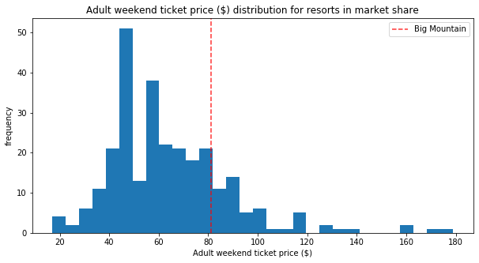
Results - Tests

Slide 5
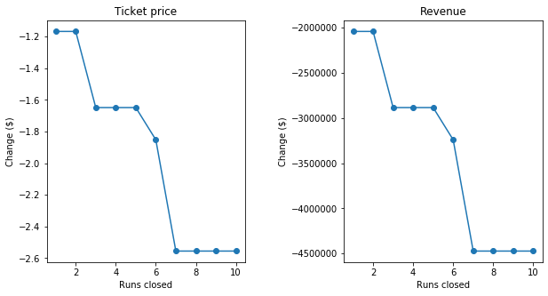
Results - Scenario 1

Slide 6
Results - Scenarios 2 and 3
2. This scenario increases support for ticket price by $16.43. Over the season, this could be expected to amount to $28745370.
3. This scenario increases support for ticket price by $18.69. Over the season, this could be expected to amount to $32699074.

Slide 7
Summary and conclusion
increase the resort’s vertical drop,
install an additional lift, and
add two acres of snow making

